Slide 1

Central Lakes College
Ag and Energy Center
“Using irrigation to save our environment”
Keith Olander, Dean of Agricultural Studies, Central Lakes College

Slide 2

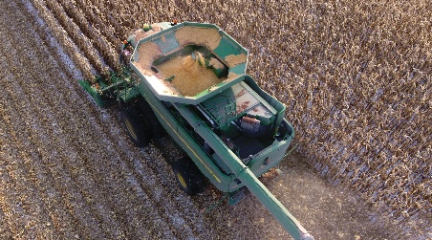
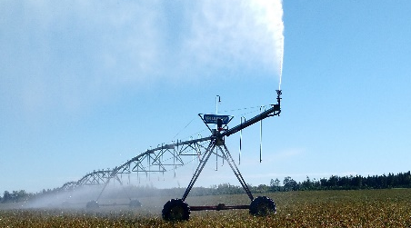
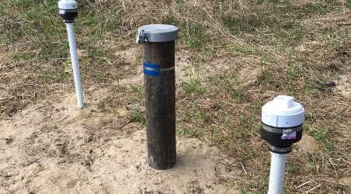
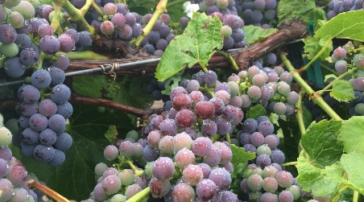
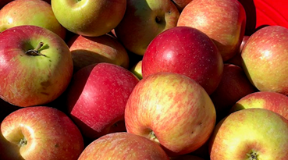
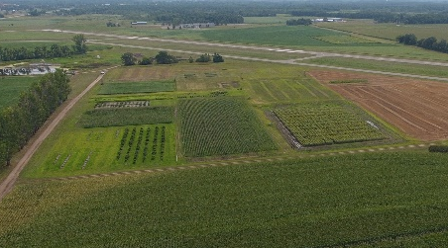
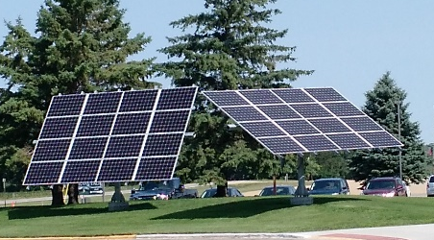
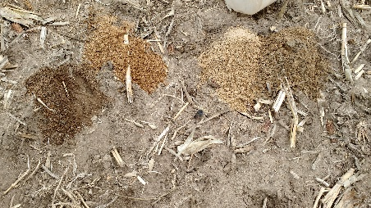
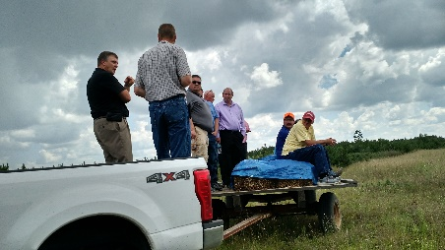
Mission:
Ag & Energy was founded in 1968.
Central Lakes College Ag and Energy Center builds futures as it delivers valuable products, services, and education, which contributes to the economic vitality of the region.
Priorities:
Precision Ag Demo
Irrigation
Water Quality
Viticulture
Local Foods
Ag Industry Research
Alternative Energy
Soil Health
Ag Literacy

Slide 3
2019 Research Projects
AgXplore – Nitrogen treatment
AgXplore – strip trials
ADM & Provita – edible beans
Byron Site Water quality
Byron Site Cover Crop Grazing
Corn & Soybean variety trials – genetics
Renk Seed Show Plot
UMN Hazelnuts
UMN Kernza
UMN/RDO Potatoes
USDA Sunflowers
UMN/AURI Cover Crop/water Quality
Demonstration
  Living Legacy Gardens
  Blueberries
  Community Gardens
  Apple Orchard
  Vineyard
  Education Partners
    Central MN Irrigators
    Crow Wing Forage Council

Slide 4
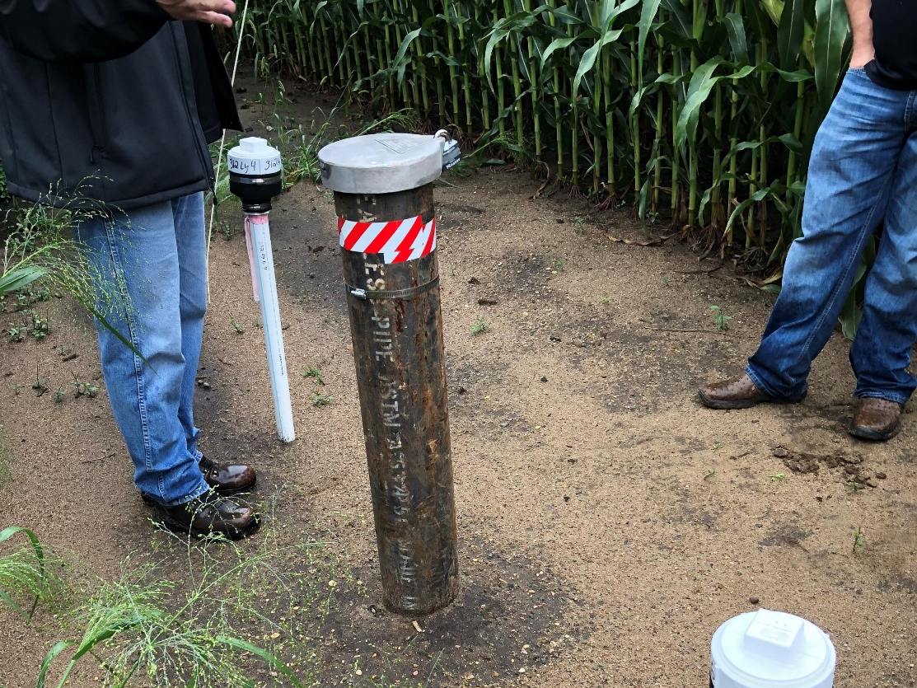
Why do farmers irrigate?
Economically:
  Irrigated crops in coarse, sandy soils is more profitable. (see hand-out)
Environmentally:
  Irrigated land mitigates loss of nitrogen at a greater rate over time due to better plant uptake and ability to “spoon-feed” nitrogen.
When a farmer can minimize loss of nitrogen – it is a smart management move financially, and serves his/her environmental stewardship calling.

Slide 5
Perceptions vs reality:
The more a producer irrigates, the greater to crop.
  False, to a point of meeting crop needs, a producer seeks to satisfy plant, but beyond its needs, it costs money for water, energy, and equipment.
Today’s farm economics are in a depressed setting – not allowing for any mismanagement.
Amplifying agency impact when farmer’s future’s are held in the balance during economic crisis.
Current well measurements do not show negative impact in water abundance.
Past agricultural practices have caused negative impacts to ground water quality. That past should not prohibit wise use of resources going forward.
Several industries has contributed to environmental degradation, they change with technology and research - agriculture/irrigation is no different.
Reduction of Nitrates, without losing production
Reduction of Nitrogen rates without yield loss

Slide 6
Farm Economics in 2019

Slide 7
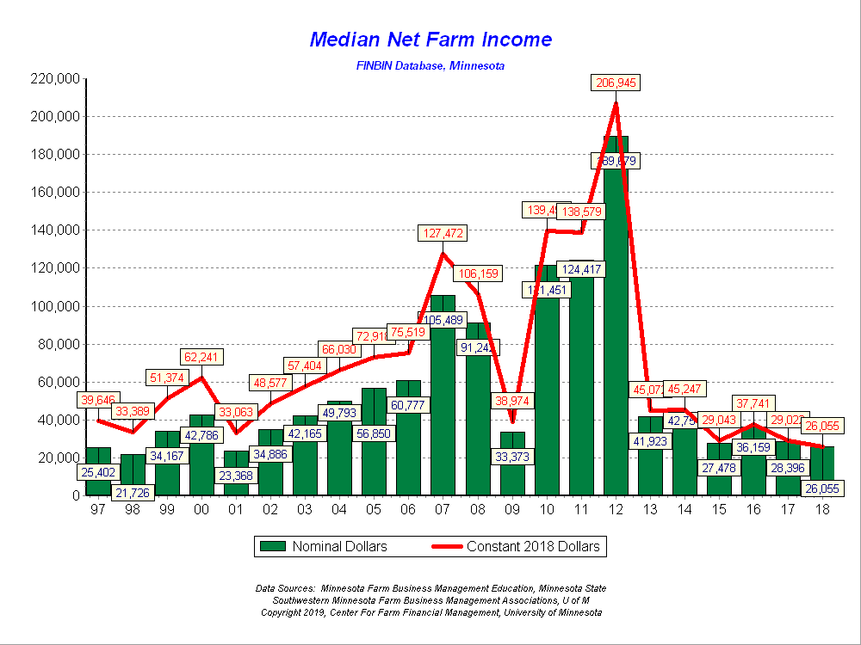
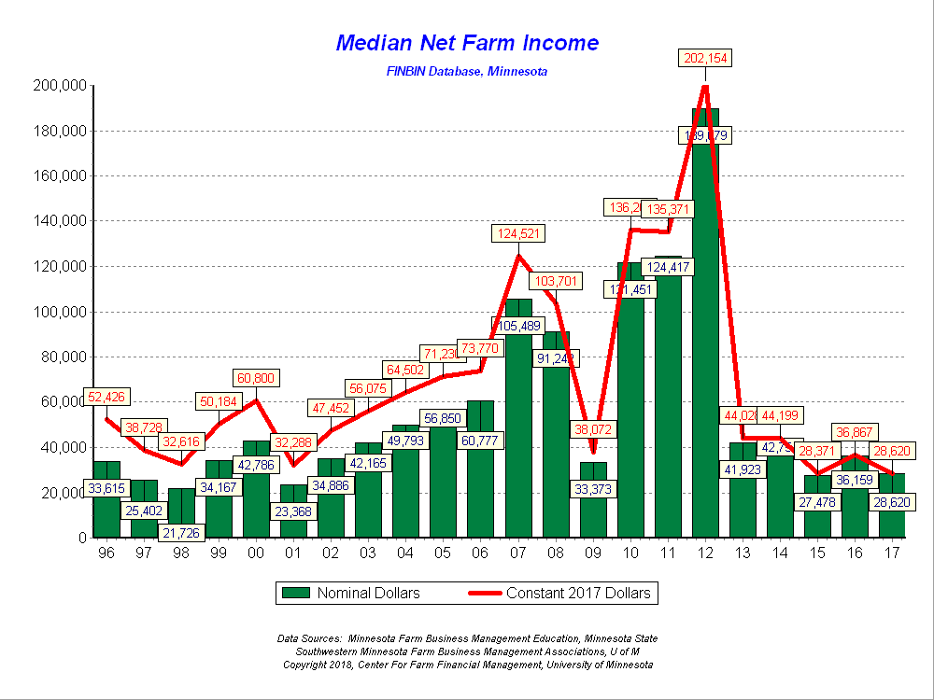

Slide 8
What is Net Farm Income used for?
$84,015
Necessary Expenditures exceeded Revenue Source

Slide 9
Research Based Decision Making

Slide 10
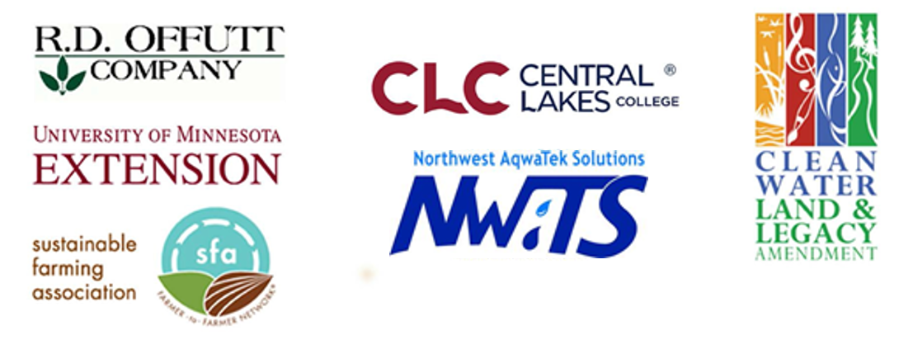
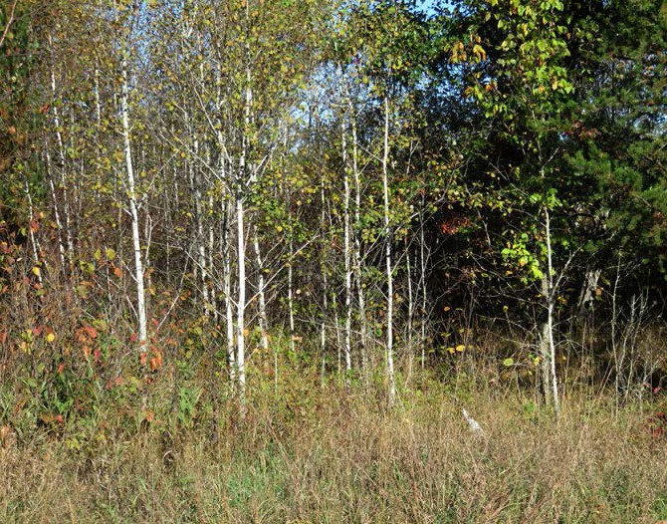
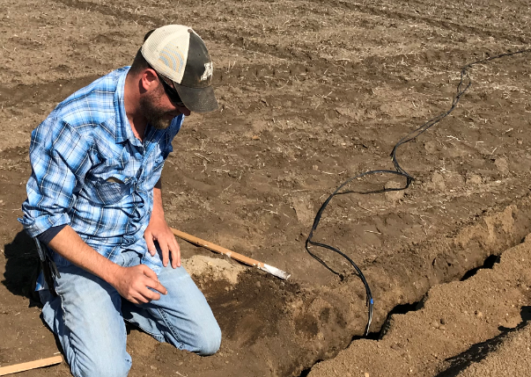
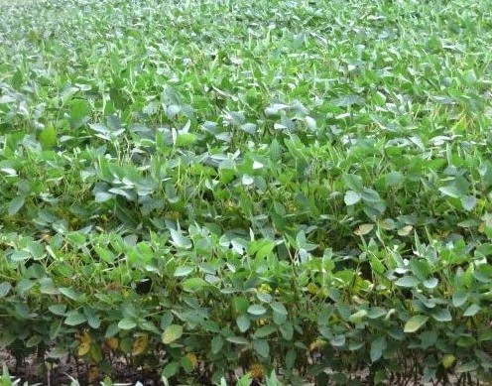
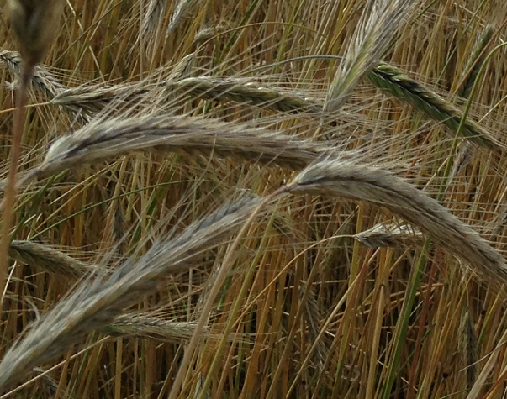
Byron Township
Water Quality Study
In cooperation with
Partnership
Monitoring
Timeline
Timber Production
Prior to 2013
Monitoring Installation
2014
Irrigated Production
2014-Forward
Adaptive Management
Ongoing

Slide 11
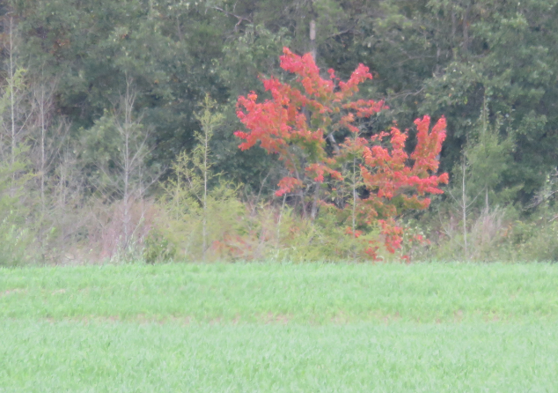
Byron Township
Water Quality Study
Project goal: balance financial and environmental sustainability
Practices
  Specialized crop rotation
  Nitrogen BMPs: rate, timing, placement
  Cover crops
  Results
  Data shows reduced impact on water quality
  Financial goals not yet reached

Slide 12
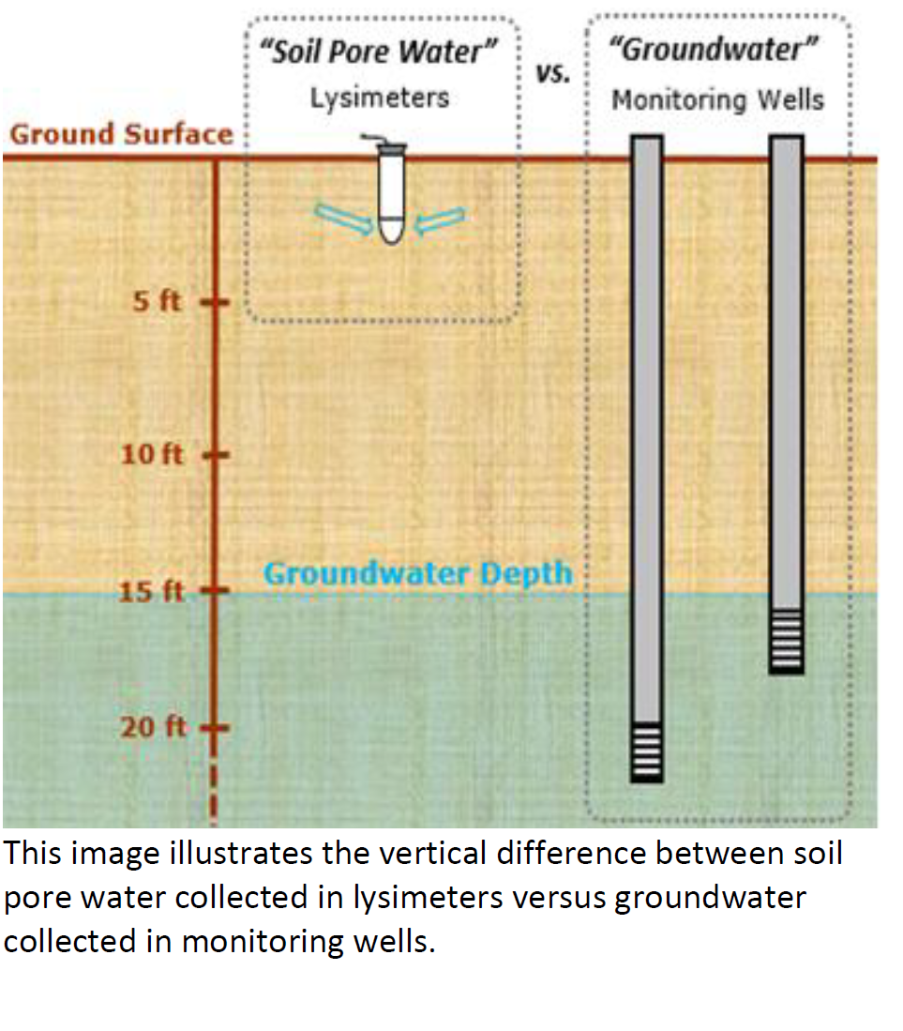
Knowing your terminology:

Slide 13
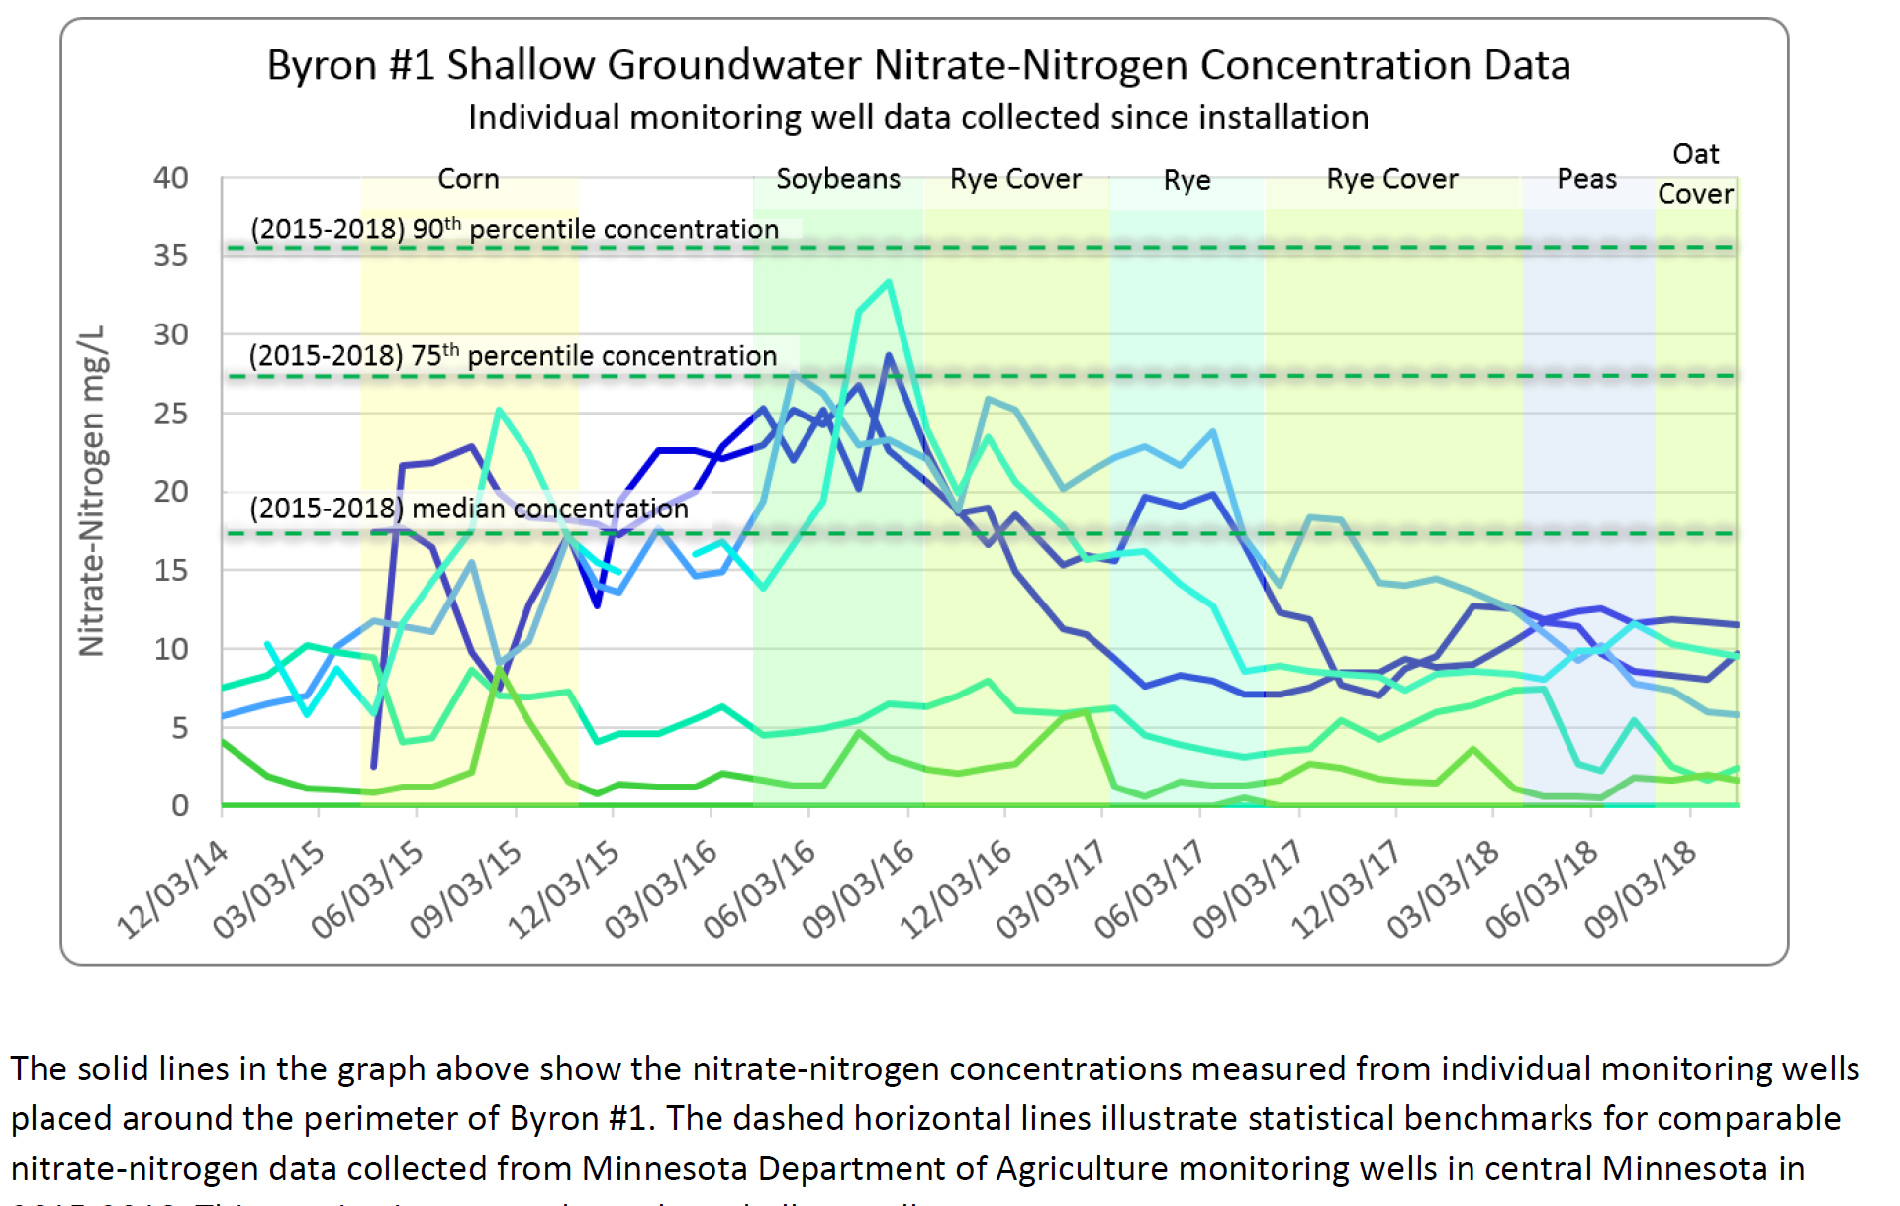
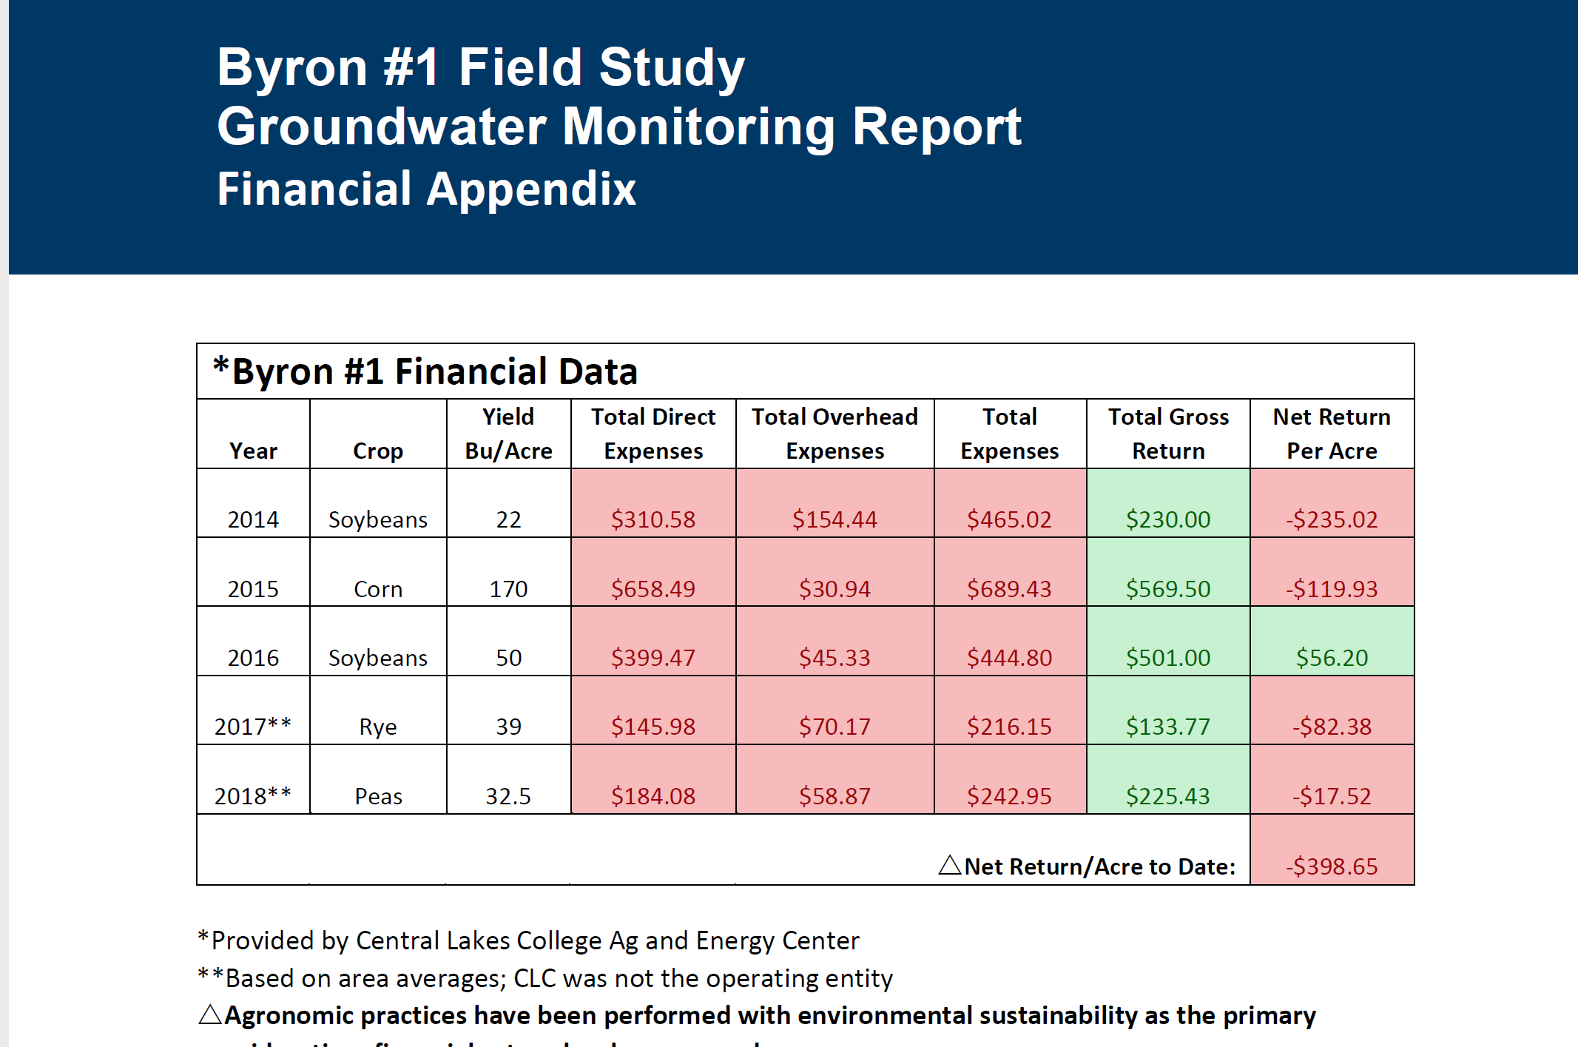
The Farmer’s Balance:
Environmental-Economic

Slide 14

Thank you for your time!
“Using irrigation to save our environment”

